Slide 1
Hyperscale Proof of Concept
Antonio Santana | John Hong | Nicholas Gabble | Troy Mateo
Notes:
What, exactly, is “the Cloud”? Is it a network of machines connected via the Internet scattered all over the globe? Is it a data center environment located in the United States or anywhere in the world? Is it really just “someone else’s computer”? Or, is there more to it that needs to be understood by the Information Security professional, to arm him or her with enough knowledge to answer the tough question that inevitably will be asked by their employer, “Why should we take the risk to move our most sensitive data into the cloud?” To take it one step further, should in the event of a data breach that same employer should say, “We need to investigate how this happened;” what exactly will the Information Security professional need to know to successfully conduct a digital forensic investigation, especially if he or she doesn’t have direct access to the server or hardware?

Slide 2
Introduction
Project Overview
Network Design
AD & DNS Services
Front-End
Back-end
Live Demo
Getting Started
Lessons Learned
Notes:
Sequence of events
Network
Front-End
Active Directory
Back-End
Bitly

Slide 3


Project Overview
Created two Virtual Machines with Windows 2019 server and Web services (IIS) with a functioning website.
Incorporated AD & DNS services for login and IP resolution and user rights.
Developed a database backend to add data to the database.
Configured the firewalls to allows RDP, HTTP, and ICMP traffic
Created a virtual load-balancer capable of distributing traffic between web servers and routing of website traffic.
Setup cloud performance metrics to manage infrastructure.
Notes:
Present a live working cloud solution to Microsoft senior managers for project approval using the following:
Create two Virtual Machines with Windows 2016/2019 server and Web services (IIS) with a functioning website
Incorporate AD & DNS services for login and IP resolution and user rights
Develop a database backend to add data to the database
Create a virtual firewall that allows RDP, HTTP, and ICMP traffic
Create a virtual load-balancer capable of distributing traffic between web servers and routing of website traffic
Setup cloud performance metrics to manage infrastructure

Slide 4
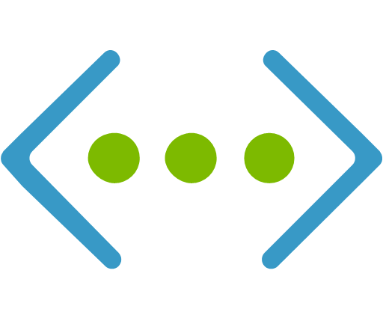
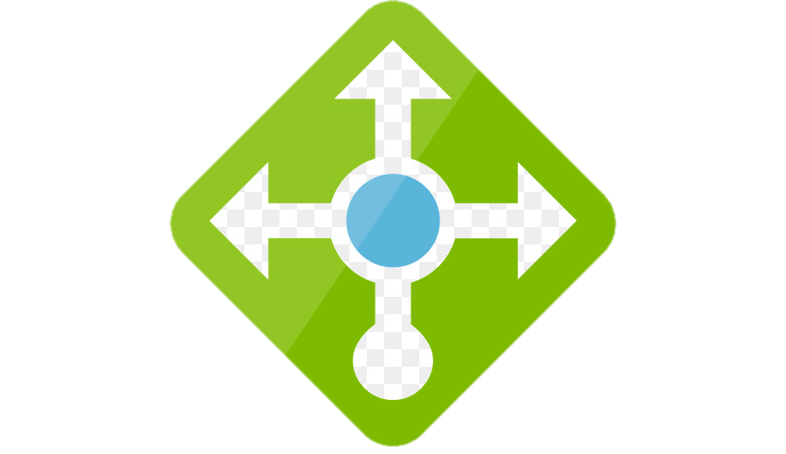
Network Design
Network Lead responsible for the creation of virtual network, virtual machines, and load balancing.
Established virtual network on 10.1.1.0/24
Created virtual machines within the same availability set
Virtual machines and load balancer enable different firewall rules to allow different functions
Load balanced the virtual machines to redirect web traffic in the event of server shutdown
Notes:
Load balancer
High availability – availability set.
Created VMs
Firewall rules
Static IP address

Slide 5
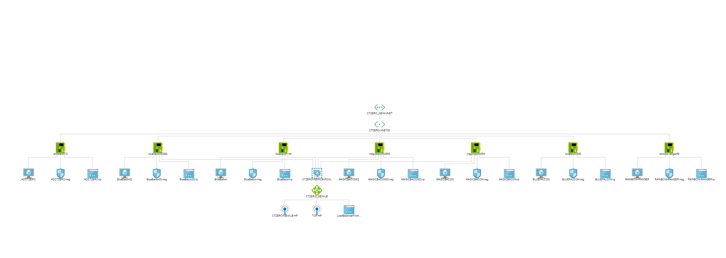
Network Topology

Slide 6
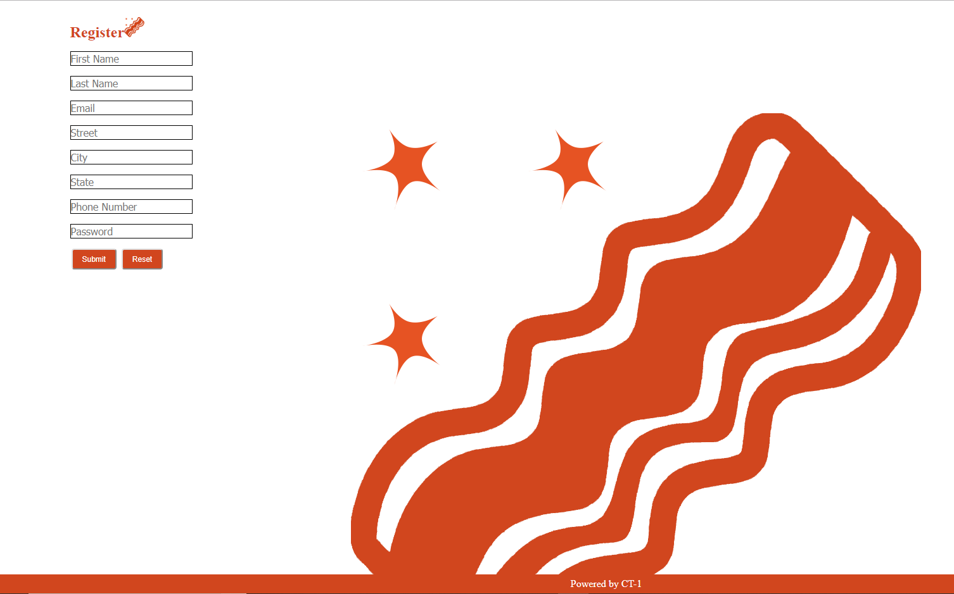
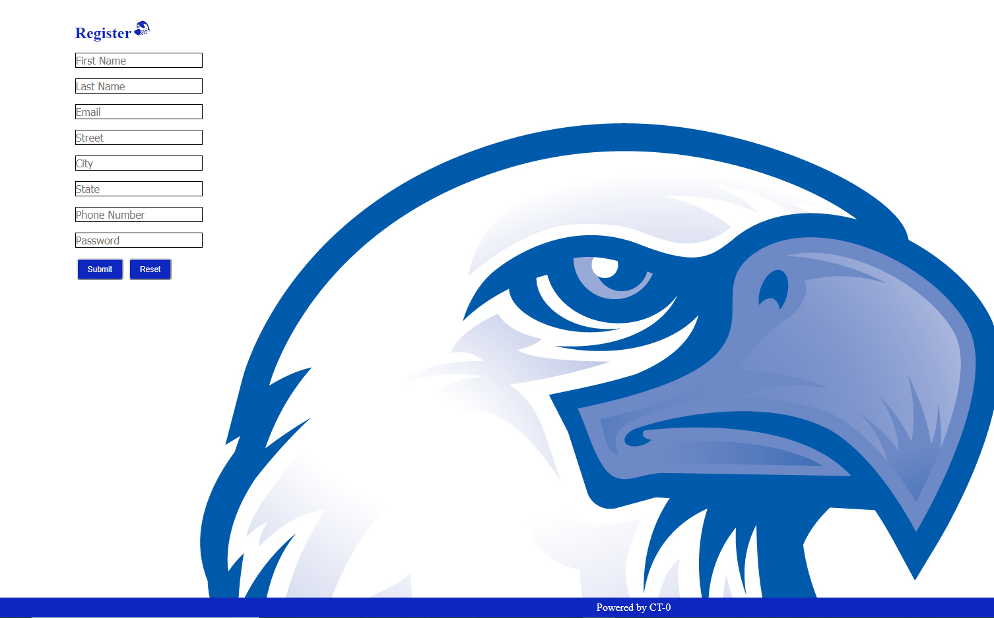
Front-End
ASPX
Pros and Cons
HTML and CSS
Ubiquity
Modularity
Notes:
All ASP.NET pages that require authentication must set the System.Web.UI.Page.ViewStateUserKey property to a unique value per user (such as the user's session ID) to help protect the application against Cross-Site Request Forgery attacks.

Slide 7
AD & DNS Services
Enable centralized computer and user authentication.
Windows Server 2019
CTZero Domain
Joined all virtual machines to the domain.
Host-based firewall configured with the domain profile.
Maintain DNS records for organization.

Slide 8
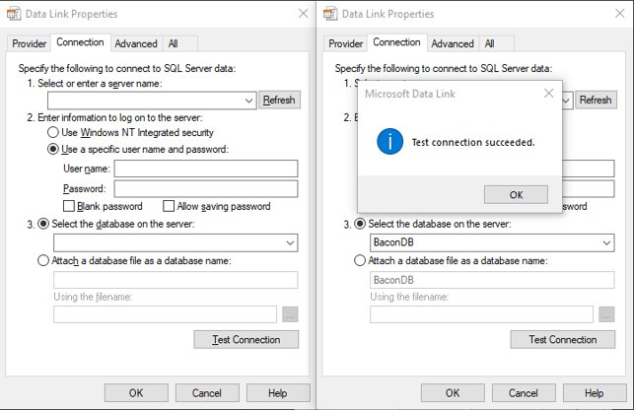
Server/Database: The Back-end
Enable Remote Publishing
SQL Server Express 2017/SQL Server Management Studio
Database creation, TCP/IP connection, inbound rule additions
Establish Connection between SQL Server VM and Site VMs

Slide 9
Hyperscale Project Demo
Notes:
SCRM acknowledges that the origin of system components cannot always be controlled.
Business Operations
Infrastructure
Data
Include SCRM into Rockwell's security program.
Managing risks related to manufacturing and delivery supply chains.
Process to identify supply chain risks, threats, vulnerabilities, likelihood, and determining the impact to develop mitigation strategies.
Ensure controls are used to prioritize efforts.

Slide 10
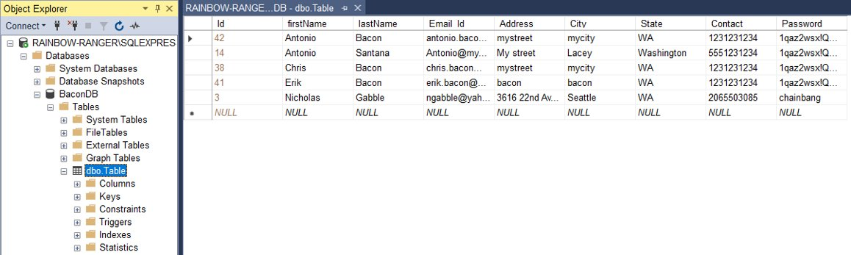
SQL Database View

Slide 11
Getting Started
Import Users PowerShell script
Microsoft PFE Assessment Tool
Customizable Webpage options
SQL deployment documentation
Network diagram and IP cutsheet
Web Application Gateway
Notes:
Microsoft PFE assessment tool: ~~ AD ACL Scanner ~~ Produces visual reports of nonstandard permission anomalies and advanced elevation/dumping backdoors inserted in your Active Directory by malicious actors or unknowingly by admin activities.
https://t.co/7g1MWEeIWt
Setup cloud performance metrics to manage infrastructure

Slide 12
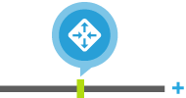

Azure Web Application Gateway
Web Application Firewall
The WAF protects against the following web vulnerabilities:
SQL-injection attacks
Cross-site scripting attacks
HTTP protocol anomalies, such as missing host user-agent and accept headers
Bots, crawlers, and scanners
Common application misconfigurations (for example, Apache and IIS)
Common web vulnerabilities and exploits like SQL Injection or Cross site scripting.
Notes:
Open Web Application Security Project (OWASP)
Efficient, secure web front end
Azure Application Gateway gives you application-level routing and load balancing services that let you build a scalable and highly-available web front end in Azure. You control the size of the gateway and scale your deployment based on your needs.
Protect your application from common web vulnerabilities and exploits like SQL Injection or Cross site scripting. Customize rules to reduce false positives.
Close integration with Azure services
SSL offload lets you build a secure web front end with efficient backend servers and also streamline your certificate management.
Application Gateway gives you easy integration with Azure Traffic Manager to support multi-region redirection, automatic failover, and zero-downtime maintenance. Application Gateway is also integrated with Azure Load Balancer to support scale-out and high-availability for Internet-facing and internal-only web front ends.

Slide 13
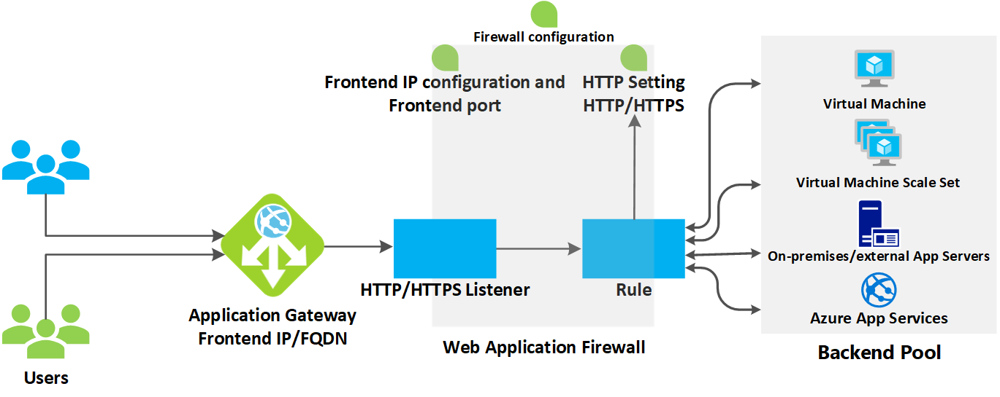
Azure Web Application Gateway
Scalable, highly-available web application delivery
Web Application Firewall
Common web vulnerabilities and exploits like SQL Injection or Cross site scripting.
Efficient, secure web front end
Close integration with Azure services
Notes:
Azure Application Gateway gives you application-level routing and load balancing services that let you build a scalable and highly-available web front end in Azure. You control the size of the gateway and scale your deployment based on your needs.
Protect your application from common web vulnerabilities and exploits like SQL Injection or Cross site scripting. Customize rules to reduce false positives.
SSL offload lets you build a secure web front end with efficient backend servers and also streamline your certificate management.
Application Gateway gives you easy integration with Azure Traffic Manager to support multi-region redirection, automatic failover, and zero-downtime maintenance. Application Gateway is also integrated with Azure Load Balancer to support scale-out and high-availability for Internet-facing and internal-only web front ends.

Slide 14
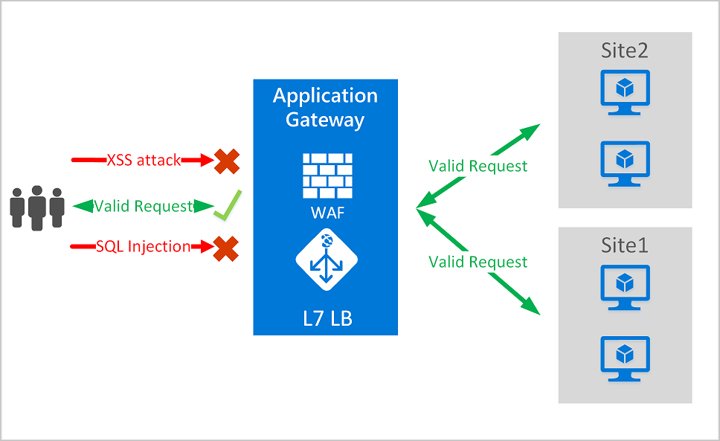
Notes:
Application Gateway WAF is integrated with Azure Security Center. Security Center provides a central view of the security state of all your Azure resources.

Slide 15
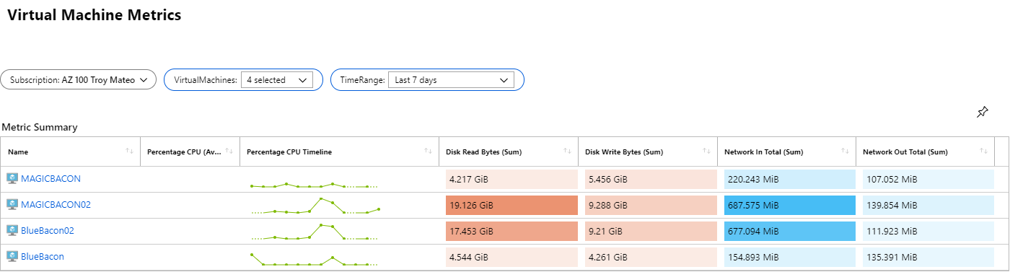
Key Web Server Metrics

Slide 16
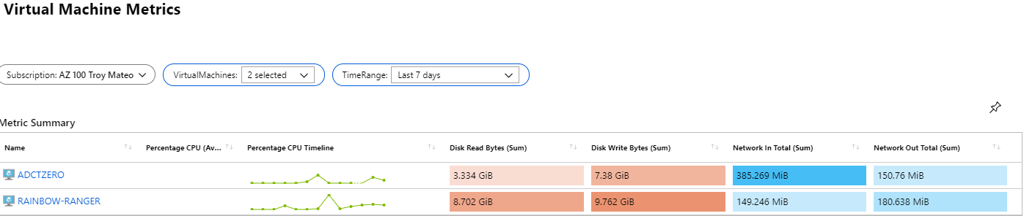
Key Infrastructure Server Metrics

Slide 17
Hyperscale Project Lessons Learned
Notes:
SCRM acknowledges that the origin of system components cannot always be controlled.
Business Operations
Infrastructure
Data
Include SCRM into Rockwell's security program.
Managing risks related to manufacturing and delivery supply chains.
Process to identify supply chain risks, threats, vulnerabilities, likelihood, and determining the impact to develop mitigation strategies.
Ensure controls are used to prioritize efforts.

Slide 18
Lessons Learned
Server/Database
Service installation hierarchy
Website Deployment
Database table
Network
Creating a virtual network
Setting up load balancer with appropriate rules
Virtual machines initial creation in correlation with LB
Setting up VM's with appropriate rules
Software Development
Iterate Often
Avoid Scope Creep
Allow your team to self-organize
Notes:
Hands-on experience with the Azure/AWS Portals, building virtual compute, network, security, and storage configurations and solutions
Improve live demo presentation skills
Understand and be able to explain Azure/AWS cloud elements and how they work together to create an enterprise solution

Slide 19
Technical Details
Database
Integrate with website
Secure credential implementation
Input / Output validation
Use connectors
Make a table
Network
10.1.1.0/24
Gateway 10.1.1.1
Load Balancer 10.1.1.3
IIS1 10.1.1.4
IIS2 10.1.1.5
Database1 10.1.1.6
AD/DNS 10.1.1.7
Software Development
Authenticate with AD
Input / Output validation
HTML
Website with authentication
1 Page after log in
Show server status
Show the list of students
CSS

Slide 20
Useful Links
Microsoft SDL
NIST SP 800-57
OWASP Threat Modeling Cheat Sheet
OWASP Attack Surface Analysis Cheat Sheet
OWASP Threat modeling
OWASP Secure SDLC Cheat Sheet
docs.microsoft.com system.web.ui.webcontrols.button
w3schools.com
https://www.ryadel.com/en/sql-server-2017-express-edition-install-setup-configure-how-to-tutorial-guide/
https://knowledgebase.apexsql.com/configure-remote-access-connect-remote-sql-server-instance-apexsql-tools/

Slide 21
Team Roles | Team Members
Database Lead | John Hong
Developer Lead | Nicholas Gabble
Network Lead | Troy Mateo
Management / Security | Antonio Santana
Notes:
|

